Slide 1

Chapter 12
Managing New Product Development Teams
Strategic Management of Technological Innovation, 7th Edition
Melissa A. Schilling
© McGraw Hill LLC. All rights reserved. No reproduction or distribution without the prior written consent of McGraw Hill LLC.

Slide 2
Magna International’s Carbon Fiber “Lightweighting Project” 1
Magna International is a $32.6 billion Canadian company that makes components and technologies for the auto industry.
In 2007, Magna began developing a carbon-fiber reinforced plastic that would help make cars lighter, rust proof, and easier to assemble. They chose a senior plastics engineer known for challenging the status quo to serve as project lead, and assembled the rest of the core team from people spread across “Centers of Excellence” in Canada, Europe, and the U S.
Only seven people were full time, and all were engineers but came from different engineering specialties. Each Center worked on different aspects of the project such as material development, manufacturing development, and business models.

Slide 3
Magna International’s Carbon Fiber “Lightweighting Project” 2
Team member compensation was a combination of salary plus bonus, where bonus was based on successful implementation of the project as a team (60%) and individual contribution (40%).
Furthermore, all employees had stock in the firm.
There was frequent debate and to save time, decisions were made via vote, not consensus.
B M W ultimately decided to make carbon fiber in house rather than contract with an external provider, but Magna earned awards for its carbon fiber development and became known worldwide as an innovator.

Slide 4
Magna International’s Carbon Fiber “Lightweighting Project” 3
How would you characterize the structure of the core team used by Magna for the lightweighting project? What do you think are the pros or cons of this type of team for this project?
What do you think the benefits and costs were of Magna’s team working across three different geographic locations? Do you think those benefits and costs would be different today given the advances that have been made in communications technologies?
What are the pros and cons of Paulette’s approach of having the teams vote on decisions? What other alternatives are there, and what are their pros and cons?

Slide 5
Overview
Many organizations now use cross-functional teams to lead and manage the N P D process.
There is considerable variation in how these teams are formed and managed.
The chapter will look at size, composition, structure, administration, and leadership of teams.

Slide 6
Constructing New Product Development Teams 1
Team Size.
May range from a few members to hundreds.
Bigger is not always better; large teams create more administrative costs and communication problems.
Large teams have higher potential for social loafing.
Team Composition.
Including members from multiple functions of firm ensures greater coordination between functions.
Firms around the world rely heavily on cross-functional teams for their new product development efforts.

Slide 7
Constructing New Product Development Teams 2
Diversity in functional backgrounds increases breadth of knowledge base of team.
Other types of diversity (for example, organizational tenure, cultural, gender, age, etc.) can be beneficial as well.
Provides broader base of contacts within and beyond firm.
Ensures multiple perspectives are considered.
However, diversity can also raise coordination costs.
Individuals prefer to interact with those they perceive as similar (“homophily”).
May be more difficult to reach shared understanding.
May be lower group cohesion.
Extended contact can overcome some of these challenges.

Slide 8
Research Brief 1
Why Brainstorming Teams Kill Breakthrough Ideas.
Dozens of laboratory studies have shown that brainstorming groups produced fewer ideas and ideas of less novelty than the sum of the ideas created by the same number of individuals working alone.
Three main reasons:
Fear of Judgment – people self-censor many of their most creative ideas for fear of being judged.
Production Blocking – when one person is talking, others are blocked from ideating.
Feasibility Trumps Originality – groups tend to weight “feasible” more highly than “original”.
Indicates that people should brainstorm alone first and elaborate their ideas before moving into team development.

Slide 9
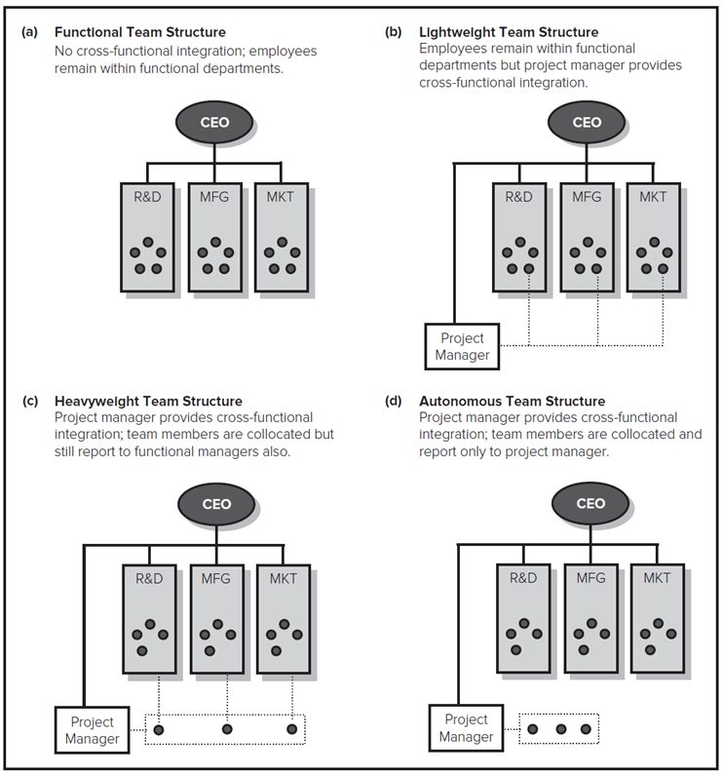
Structure of New Product Development Teams 1
One well-known typology of team structure classifies teams into four types:
Functional.
Lightweight.
Heavyweight.
Autonomous.
Access the text alternative for these images.

Slide 10
Structure of New Product Development Teams 2
Functional Teams.
Members report to functional manager.
Temporary, and members may spend less than 10% of their time on project.
Typically no project manager or dedicated liaison personnel.
Little opportunity for cross-functional integration.
Likely to be appropriate for derivative projects.
Lightweight Teams.
Members still report to functional manager.
Temporary, and member may spend less than 25% of their time on project.

Slide 11
Structure of New Product Development Teams 3
Typically have a project manager and dedicated liaison personnel.
Manager is typically junior or middle management.
Likely to be appropriate for derivative projects.
Heavyweight Teams.
Members are collocated with project manager.
Manager is typically senior and has significant authority to command resources and evaluate members.
Often still temporary, but core team members often dedicated full-time to project.
Likely to be appropriate for platform projects.

Slide 12
Structure of New Product Development Teams 4
Autonomous Teams.
Members collocated and dedicated full-time (and often permanently) to team.
Project manager is typically very senior manager.
Project manager is given full control over resources contributed from functional departments and has exclusive authority over evaluation and reward of members.
Autonomous teams may have own policies, procedures and reward systems that may be different from rest of firm.
Likely to be appropriate for breakthrough and major platform projects.
Can be difficult to fold back into the organization.

Slide 13
The Management of New Product Development Teams 1
Team Leadership.
Team leader is responsible for directing team’s activities, maintaining alignment with project goals, and communicating with senior management.
Team leaders impact team performance more directly than senior management or champions.
Different team types need different leader types:
Lightweight teams need junior or middle manager.
Heavyweight and autonomous teams need senior manager with high status, who are good at conflict resolution, and capable of influencing engineering, manufacturing, and marketing functions.

Slide 14
The Management of New Product Development Teams 2
Team Administration.
Many organizations now have heavyweight and autonomous teams develop a project charter and contract book.
Project charter encapsulates the project’s mission and provides measurable goals. May also describe:
Who is on team.
Length of time members will be on team.
Percentage of time members spend on team.
Team budget.
Reporting timeline.
Key success criteria.

Slide 15
The Management of New Product Development Teams 3
Contract book defines in detail the basic plan to achieve goals laid out in charter. It provides a tool for monitoring and evaluating the team’s performance. Typically provides:
Estimates of resources required.
Development time schedule.
Results that will be achieved.
Team members sign contract book; helps to establish commitment and sense of ownership over project.

Slide 16
The Management of New Product Development Teams 4
Managing Virtual Teams.
In virtual teams, members may be a great distance from each other, but are still able to collaborate intensely via videoconferencing, groupware, email, and internet chat programs.
Enables people with special skills to be combined without disruption to their personal lives.
However, may be losses of communication due to lack of proximity and direct, frequent contact.
Requires members who are comfortable with technology, have strong interpersonal skills and work ethic, and can work independently.

Slide 17
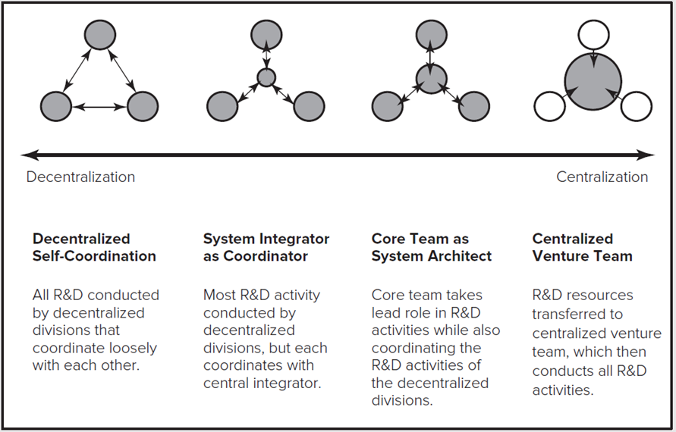
Research Brief 2
Virtual International R&D Teams.
Gassmann and von Zedtwitz studied 34 technology-intensive multinationals and identified four patterns of virtual international R&D teams:
Access the text alternative for these images.

Slide 18
Discussion Questions
Why are the tradeoffs in choosing a team's size and level of diversity?
What are some of the ways that managers can ensure that a team reaps the advantages of diversity while not being thwarted by some of the challenges team diversity raises?
Can you identify an example of a development project, and what type of team you believed they used? Do you think this was the appropriate type of team given the nature of the project?
What are some of the advantages and disadvantages of co-location? Are there some types of projects for which “virtual teams” are inappropriate?

Slide 19
End of Main Content
© McGraw Hill LLC. All rights reserved. No reproduction or distribution without the prior written consent of McGraw Hill LLC.

Slide 20
Accessibility Content: Text Alternatives for Images

Slide 21
Structure of New Product Development Teams 1 – Text Alternative
Return to parent-slide containing images.
The types of development teams are a, functional team structure, b, lightweight team structure, c, heavyweight team structure, and d, autonomous team structure. In part a, no cross functional integration; employees remain within functional departments. An arrangement in which R and D, manufacturing, and marketing teams with five members each are under the C E O is shown below. In part b, employees remain within functional departments but project manager provides cross functional integration. An arrangement in which R and D, manufacturing, marketing teams with five members each, and Project Manager are under the C E O is shown below. In part c, Project manager provides cross functional integration; team members are collocated but still report to functional managers also. An arrangement in which R and D, manufacturing, marketing teams with four members each and Project Manager are under the C E O is shown below. Project Manager is linked to R and D, manufacturing, and marketing teams through respective members. In part d, Project manager provides cross functional integration; team members are collocated and report only to project manager. An arrangement in which R and D, manufacturing, marketing teams with four members each and Project Manager are under the C E O is shown below. Project Manager with three members is linked to R and D, manufacturing, and marketing teams.
Return to parent-slide containing images.

Slide 22
Research Brief – Text Alternative
Return to parent-slide containing images.
A horizontal arrow ranges from decentralization to centralization above which four arrangements are shown. The first decentralized self coordination arrangement shows three interconnected shaded circles representing all R and D conducted by decentralized divisions that coordinate loosely with each other. The second system integrator as coordinator arrangement shows three shaded circles interconnected to a smaller shaded circle at the center representing most R and D activity conducted by decentralized divisions, but each coordinates with a central integrator. The third core team as system architect arrangement shows three shaded circles interconnected to a shaded circle at the center representing core team takes a lead role in R and D activities while also coordinating the R and D activities of the decentralized divisions. The fourth centralized venture team arrangement shows three unshaded circles connected to a larger shaded circle at the center representing R and D resources transferred to centralized venture team, which then conducts all R and D activities.
Return to parent-slide containing images.

